Slide 1
Embedded Systems
CDAC Mumbai

Slide 2
Embedded Systems
Definition:-
“ An embedded system is a microcontroller based software driven, real time control system, which may be autonomous or human or network interactive, operating on diverse physical variables and in diverse environments”

Slide 3
Where do we find Embedded Systems
Home appliances
Microwave ovens, washing machines,
Entertainment devices
TV, DVD players, MP3 players
Telecommunication
Mobile phones, Telephones
Computers
Keyboards, Disk drives
Automobiles
Dashboard, Fuel Injection, suspension, GPS

Slide 4
Characteristics
Principal function is control and not computation
Usually designed to perform selected functions at a low cost
Microcontroller or Microprocessor is embedded
Firmware is embedded in hardware devices
Programs need to run with real-time constraints with limited hardware resources
These systems meet their real-time constraints with a combination of special purpose hardware and software tailored to the system requirements.
Embedded systems reside in machines that are expected to run continuously for years without errors.
the software and Firmware is usually developed and tested more carefully than Software for Personal computers
Some embedded system may be outside the reach of humans

Slide 5
Subsystems
Three main subsystems
Microcontroller
Memory
To store program
To store data
Input Output
Interconnecting elements

Slide 6
Microcontroller Characteristics
Input/Output intensive
‘on-chip’ peripherals
Physically small
Simple program and data storage requirement
Instruction set optimised for embedded environment
Yields compact code
Limited arithmetic capability
Limited addressing capability
Strong in bit manipulation
Low cost
Extended temperature range/low power

Slide 7
Processor Architecture (Memory)
Princeton or Von-neuman
Harvard
Single Main Memory holding both program and data
Simple memory structure
Data memory is idle when program is fetched
Storing or modifying programs is easy
Bottleneck on buses
Pin count is reduced
Ex. 8085, x86
Contains two separate memory spaces- code & data
Complex memory Structure
Instructions can be fetched simultaneously with instruction execution

Slide 8
Processor Architecture (Memory)
Princeton or Von-neuman
Harvard
PROGRAM MEMORY
PROGRAM MEMORY
DATA BUS
DATA BUS
ADDRESS BUS
CPU
CPU
ADDRESS BUS
DATA BUS
ADDRESS BUS
DATA MEMORY, PERIPHERALS
DATA MEMORY, PERIPHERALS

Slide 9
Processor Design
Microprocessors are Instruction Set Processors(ISP)
Executes instructions from a predefined instruction set
Functionality is characterized by the instruction set it is capable of executing
All programs that run on it are encoded in that instruction set
This predefined instruction set is also called as Instruction Set Architecture (ISA)
ISA serves as an interface between
Hardware and software
Programs and processor
Performance Equation
time program
time cycle
cycles instruction
instructions program
=
X
X

Slide 10
Instruction Set Architectures (ISA)
RISC
CISC
Reduced Instruction Set Computer
RISC approach attempts to reduces the cycles per instruction at the cost of the number of instructions per program.
Emphasis on software
Fixed length instructions
Large Register bank
Load & Store Architecture
Complex Instruction Set Computer
CISC approach attempts to minimize the number of instructions per program, sacrificing the number of cycles per instruction.
Emphasis on hardware
Variable length instruction
Small Register Bank
Memory Operands

Slide 11
Instruction Set Architectures (ISA)
RISC
CISC
Nearly all instructions executes in fixed time.
Few addressing Modes
Efficient instruction pipeline
Less silicon area required, so more peripherals added
Variable execution time for Instructions.
Many Addressing Modes
Mostly not implement any pipelining
More silicon area required, very few peripherals may added

Slide 12

Life Cycle of an Instruction
As the instruction moves through the processor it goes through the following stages.
Fetch : Instruction fetched from the address stored in the program counter.
Decode : Instruction decoded and registers read
Execute : in the ALU
Write back : Results written back to registers or memory.
• Note : each stage takes one clock cycle
• The Instruction execution requires 4 clock cycles

Slide 13
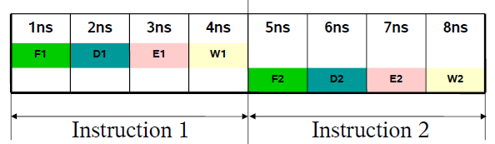
Non Pipelined Example
2 instructions take 4ns each
A stage is used once every 4ns
The resultant throughput is 4 cycles per instruction (CPI)

Slide 14
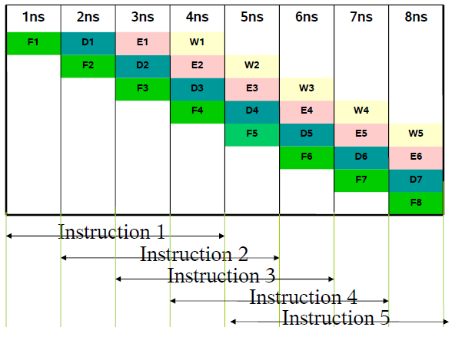
Pipelined Example
Each stage is utilized at every clock cycle.
5 Instructions are executed in 8ns
Resultant throughput is 1 instruction per cycle

Slide 15
Memory
Characteristics of ideal memory
Read and writes cycles should be fast
Large amount of information should be held in small space, dense
Data should be held indefinitely, even when power is removed, non-volatile
Low power consumption, with convenient supply voltage requirement
High reliability and durability

Slide 16
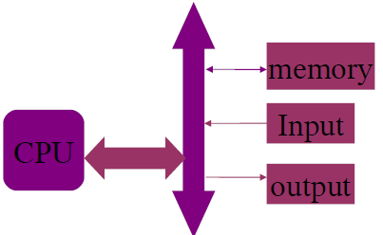
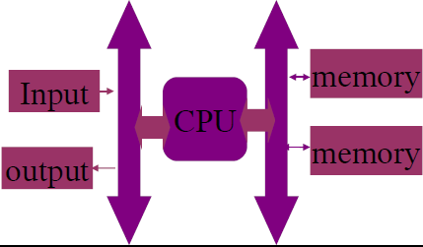
Memory Mapped IO
IO Mapped IO
IO devices are treated as like memory
Memory related instructions should be used to access IO
IO devices are separately interfaced
Separate instruction set available

Slide 17
Memory Classification
Semiconductor Memory
Volatile
Non- Volatile
Dynamic
Static
Mask Programmable ROM
Fuseable ROM
‘Field Alterable’ ROM
EPROM
EEPROM
Flash

Slide 18
The Memory Array
Solid state memory is made of large number of memory cells each of which hold one bit of information
A number of fundamentally different methods are used to achieve storage in memory cell
A bistable element as in CMOS static RAM
Electrical charge stored in a capacitor as in DRAM
Electrical charge trapped on a conductor as in EPROM, EEPROM and Flash
Presence or absence of electrical connection between two conductors as in PROM

Slide 19
DRAM
Uses ‘memory’ capability of capacitor
Ideal capacitor when charged will hold its charge indefinitely and voltage can be read
Memory cell is made up of single storage capacitor and switching transistor
Charged capacitor represents logic 1
When cell transistor is switched on by word line, capacitor voltage is connected to bit line
High density memory can be made at comparatively low cost
Capacitor charge leaks and the cell has to be refreshed every 100 ms
This is cumbersome and discourages its use in smaller embedded system

Slide 20
SRAM
CMOS SRAM cells are bistable (flip-flop) cells
They are usually made of either four transistors and two resistors(4T-2R pattern) or of six transistors(6T)
Due to low density, size of RAM is small. Usually a few Kilobytes

Slide 21
EPROM
Charge can be transferred to floating gate, if drain and gate terminals are raised to high potential
Some electrons gain enough energy to gather on floating gate. This is called hot electron injection
This charge is trapped once the programming voltage is removed.
This charge alters the threshold voltage as seen by the control gate, the transistor can no longer be turned on.
Drain Gate Source
Control Gate
Floating Gate
Si0₂ insulator
Substrate

Slide 22
EPROM
Can be programmed in parts
Erasure of selected parts is not possible
Erasure is slow
In-circuit erasure and programming not possible
EPROMs have achieved wide usage in microcontroller world and many microcontrollers are available with integral EPROMs
Ceramic packaging and quartz window increases the price

Slide 23
EEPROM
Memory cell uses FNT (Fowler-Nordheim Tunneling) mechanism for transferring electron through SiO₂
Insulating layer thickness is of the order of 10nm
FNT takes much less current than hot electron injection
On chip voltage converters develop the supply voltages required
Structures are so designed that FNT effect can be reversed, so cells can be both programmed and erased electrically
Needs two transistor per cell, one with floating gate, another for bit-select

Slide 24
EEPROM Contd..
Programming and Erasure cycles tend to take different time durations
Time can vary from cell to cell and depends on cell age, as charge can become trapped in insulating oxide layers
Electrical erasure is susceptible to risk of accidental programming due to power change.
Endurance figure is specified by manufacturer, the max. number of permissible erase/write cycles
This figure applies to every memory location
EEPROM is very popular in microcontroller world
Embedded into the microcontroller
Physically outside as small serial device

Slide 25
Flash Memory
Most recent and is developing fastest
It is not byte erasable, whole block need to be erased
High density, low cost, non-volatile, fast (to read, but not to write), and electrically reprogrammable.
These advantages are overwhelming and, as a direct result, the use of flash memory has increased dramatically in embedded systems.
Most common Flash cell is ETOX (EPROM Tunnel Oxide) developed by Intel
On chip EPROM program memories of Microcontroller are getting replaced by Flash
Simpler packing is cheaper
In system programmable
Flash will also replace EEPROM, except where byte programmability of EEPROM is indispensable.

Slide 26
Input Output
On-Chip
Common peripherals are found on most uCs
UART, Digital IO, ADC , TIMER
Application Specific peripherals on custom uCs
LCD, IrDA, USB, CAN
Off-Chip
Flexibility to choose controller
Port pins have to used
Needs extra Space

Slide 27
IO Communication
A Microcontroller system must manage its communication with the device it is controlling
Programmed IO
CPU takes or delivers data under control of program
Interrupt Driven
Peripheral grabs attention of CPU when it is ready
DMA
Used for transferring large chunks of data
Not very popular with small systems

Slide 28
Managing I/O
Two common ways of managing communication
Polling
Interrupt

Slide 29
Polling
Purpose: Allows the CPU to determine the status of an I/O device..
Mechanism:
The CPU regularly polls the I/O device to determine the device’s status.
Polling requires that the CPU actively ask devices what is happening.
Polling Examples:
Has a switch been thrown?
Has an error condition occurred?
Is the data from the device ready yet?
Is the device ready to receive the data yet?

Slide 30
Polling Flowchart
Reset
Initialise
Check Device 1 status
Device needs Service
Service Device 1
Check Device N status
Device needs Service
Service Device N

Slide 31
Polling
Polling advantages:
The software to implement polling is straight forward.
Polling disadvantages:
The CPU must interact with the device even when no service is needed.
Polling response time can be long.
This is the delay between the time a device needs service and the time the CPU provides service.
The more devices that must be polled, the longer the polling response time.

Slide 32
Interrupts
Purpose:
Allows a device to get the attention of the CPU
Mechanism:
Special interrupt signals are hooked to the CPU.
When one or more of these signals are asserted, the CPU is interrupted.
When interrupted, the CPU stops doing what it was doing and jumps to an interrupt service routine (ISR).
The ISR executes code to communicate with the I/O device.
When the ISR is done, the CPU resumes the task it was doing before it was interrupted.

Slide 33
Interrupt Flowchart
ISR
Reset
Save State & Disable Interrupts
Initialise
Clear Interrupt Request
Main Loop
Service Device
Restore State & Enable Interrupts

Slide 34
Interrupt
Advantages:
The CPU must interact with devices only when they need service.
The interrupt response time is usually lower than the polling response time.
Disadvantages:
The software to implement interrupt support is more complex than it is for polling.

Slide 35
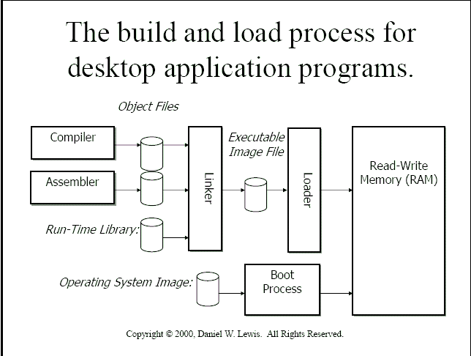

Slide 36
